Slide 1
Lecture XX Graph Algorithms
Department of Computer Science
Hofstra University
Acknowledgement: Lecture slides based on UofW Course on Data Structures

Slide 2
Inter-data Relationships
Arrays
Trees
Graphs
Elements only store pure data, no connection info
Only relationship between data is order
Elements store data and connection info
Directional relationships between nodes; limited connections
Elements AND connections can store data
Relationships dictate structure; huge freedom with connections
C
B
0 | 1 | 2
A | B | C
B
A
C
A

Slide 3
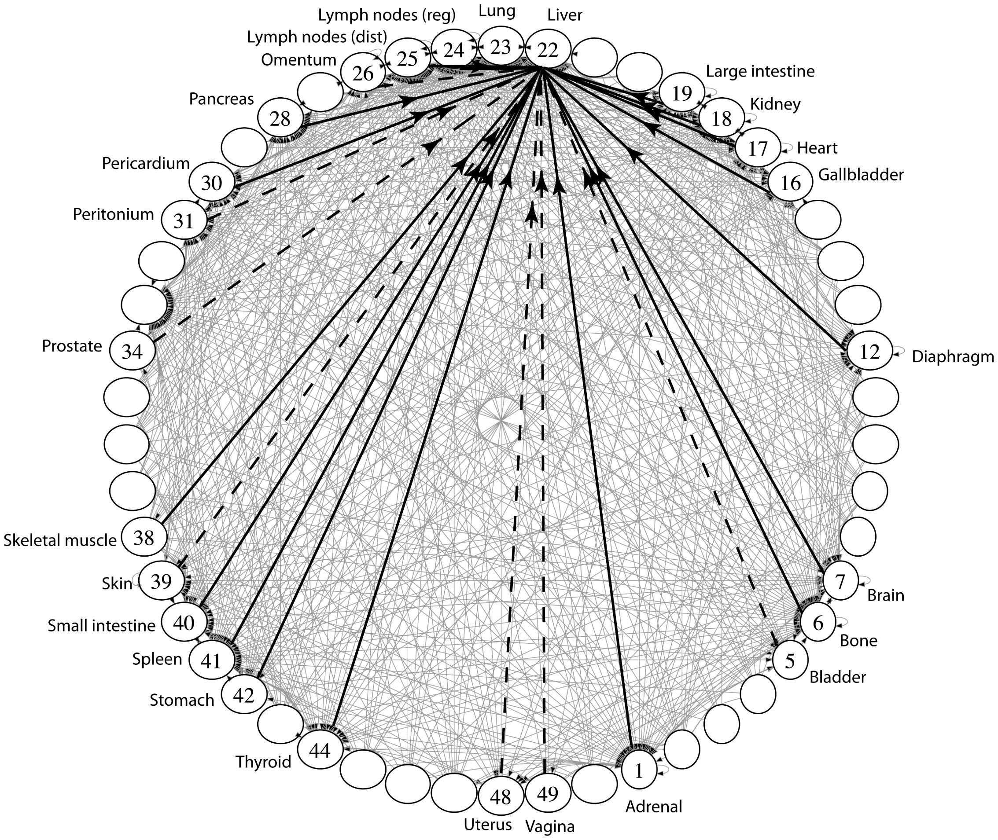
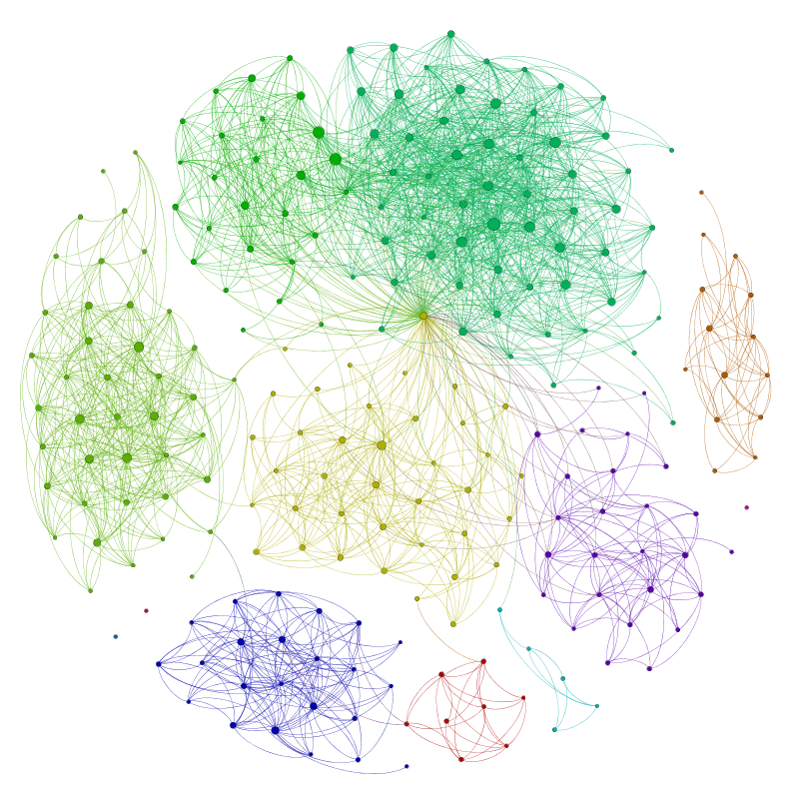
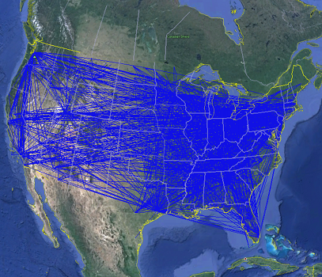
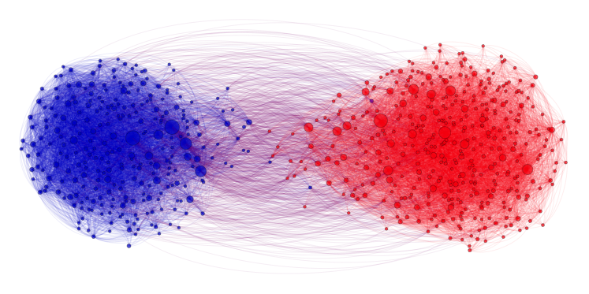
Applications
Physical Maps
Airline maps
Vertices are airports, edges are flight paths
Traffic
Vertices are addresses, edges are streets
Relationships
Social media graphs
Vertices are accounts, edges are follower relationships
Traffic
Vertices are classes, edges are usage
Influence
Biology
Vertices are cancer cell desinations, edges are migration paths
Related topics
Web Page Ranking
Vertices are web pages, edges are hyperlinks
Wikipedia
Vertices are articles, edges are links
And so many more!!
www.allthingsgraphed.com

Slide 4
Graph: Formal Definition
G
A graph is defined by a pair of sets G = (V, E) where…
V is a set of vertices
A vertex or “node” is a data entity
V = { A, B, C, D, E, F, G, H }
E is a set of edges
An edge is a connection between two vertices
E = { (A, B), (A, C), (A, D), (A, H),
(C, B), (B, D), (D, E), (D, F),
(F, G), (G, H)}
H
F
A
D
C
B
E

Slide 5
Graph Terminology
Undirected Graph:
Graph Direction
Undirected graph – edges have no direction and are two-way
V = { Karen, Jim, Pam }
E = { (Jim, Pam), (Jim, Karen) } inferred (Karen, Jim) and (Pam, Jim)
Directed graphs – edges have direction and are thus one-way
V = { Gunther, Rachel, Ross }
E = { (Gunther, Rachel), (Rachel, Ross), (Ross, Rachel) }
Degree of a Vertex
Degree – the number of edges connected to that vertex
Karen : 1, Jim : 1, Pam : 1
In-degree – the number of directed edges that point to a vertex
Gunther : 0, Rachel : 2, Ross : 1
Out-degree – the number of directed edges that start at a vertex
Gunther : 1, Rachel : 1, Ross : 1
Karen
Jim
Directed Graph:
Pam
Rachel
Gunther
Ross

Slide 6
More Graph Terminology
j
f
g
Two vertices are connected if there is a path between them
If all the vertices are connected, we say the graph is connected
A directed graph is weakly connected if replacing every directed edge with an undirected edge results in a connected graph
A directed graph is strongly connected if a directed path exists between every pair of vertices
The number of edges leaving a vertex is its degree
A path is a sequence of vertices connected by edges
A simple path is a path without repeated vertices
A cycle is a path whose first and last vertices are the same
A graph with a cycle is cyclic
e
not connected
d
b
c
a
i
p
n
connected
o
m
i
p
n
o
m

Slide 7
Directed vs Undirected; Acyclic vs Cyclic
Directed:
Undirected:
b
b
e
Acyclic:
a
d
a
d
c
c
b
b
Cyclic:
a
d
a
d
c
c

Slide 8
Labeled and Weighted Graphs
Vertex Labels
Vertex & Edge Labels
Edge Labels
b
e
c
2
c
5
a
d
a
d
a
d
1
3
b
b
c
4
Numeric Edge Labels (Edge Weights)
3
1
1
2

Slide 9
Multi-Variable Analysis
So far, we thought of everything as being in terms of some single argument “n”
With graphs, we need to consider:
n (or |V|): total number of vertices (sometimes written as V)
m (or |E|): total number of edges (sometimes written as E)
deg(u): degree of node u (how many outgoing edges it has)

Slide 10
Adjacency Matrix
4
0
1
5
6
In an adjacency matrix a[u][v] is 1 if there is an edge (u,v), and 0 otherwise.
Worst-case Time Complexity (|V| = n, |E| = m):
Add Edge:
Remove Edge:
Check edge exists from (u,v):
Get outneighbors of u:
Get inneighbors of u:
Space Complexity:
2
3
 | 0 | 1 | 2 | 3 | 4 | 5 | 6
0 | 0 | 1 | 1 | 0 | 0 | 0 | 0
1 | 1 | 0 | 0 | 1 | 0 | 0 | 0
2 | 1 | 0 | 0 | 1 | 0 | 0 | 0
3 | 0 | 1 | 1 | 0 | 0 | 1 | 0
4 | 0 | 0 | 0 | 0 | 0 | 1 | 0
5 | 0 | 0 | 0 | 1 | 1 | 0 | 0
6 | 0 | 0 | 0 | 0 | 0 | 0 | 0
O(1)
O(1)
O(1)
O(n)
O(n)
O(n * n)
Notes:
It is usual to write |V| = n and |E| = m, though sometimes we’ll abuse notation and just use V and E.

Slide 11
Adjacency List
B
A
In an adjacency matrix a[u][v] is 1 if there is an edge (u,v), and 0 otherwise.
Worst-case Time Complexity (|V| = n, |E| = m):
Add Edge:
Remove Edge:
Check edge exists from (u,v):
Get outneighbors of u:
Get inneighbors of u:
Space Complexity:
C
D
Linked Lists
0
1
2
3
O(1)
A
B
C
O(deg(u))
B
O(deg (u))
O(deg(u))
C
B
D
O(n + m)
O(n + m)
D
A

Slide 12
Adjacency List
B
In an adjacency matrix a[u][v] is 1 if there is an edge (u,v), and 0 otherwise.
Worst-case Time Complexity (assuming a good hash function so all hash table operations are O(1)) (|V| = n, |E| = m):
Add Edge:
Remove Edge:
Check edge exists from (u,v):
Get outneighbors of u:
Get inneighbors of u:
Space Complexity:
A
C
D
Hash Tables
0 | 1 | 2 | 3 | 4
0
1
2
3
O(1)
A
B
C
O(1)
B
O(1)
0 | 1 | 2 | 3 | 4
O(deg(u) )
C
B
D
O(n)
0 | 1 | 2 | 3 | 4
D
A
O(n + m)
Notes:
For this class, unless we say otherwise, we’ll assume the hash tables operations on graphs are all O(1)
Because you can probably control the keys
Unless we say otherwise, assume we’re using the hash table approach

Slide 13
Tradeoffs
Adjacency Matrices take more space, why would you use them?
For dense graphs (where m is close to n²), the running times will be close
And the constant factors can be much better for matrices than for lists
Notes:
relevant ideas for today
vertices, edges, definitions
graphs model relationships between real data (you can choose your vertices and edges to
different graph implementations exist

Slide 14
Graph Traversals
Topological Sort
Shortest Path

Slide 15
s-t Connectivity Problem
s-t Connectivity Problem
3
Given source vertex s and a target vertex t, does there exist a path between s and t?
1
6
s
0
4
7
t
2
5
An algorithm for connected(s, t)
8
We can use recursion: if a neighbor of s is connected to t, that means s is also connected to t!

Slide 16
s-t Connectivity Problem with Recursion
Solution: Mark each node as visited!
Set<Vertex> visited; // assume global
connected(Vertex s, Vertex t) {
if (s == t) {
return true;
} else {
visited.add(s);
for (Vertex n : s.neighbors) {
if (!visited.contains(n)) {
if (connected(n, t)) {
return true;
}
}
}
return false;
}
}
3
1
6
s
0
4
7
t
2
5
8
This general approach for crawling through a graph is going to be the basis for a LOT of algorithms!

Slide 17
Recursive Depth-First Search (DFS)
What order does this algorithm use to visit nodes?
Assume order of s.neighbors is arbitrary!
It will explore one option “all the way down” before coming back to try other options
Many possible orderings: e.g., {1, 2, 5, 6, 9, 7, 8, 4, 3} or {1, 4, 3, 2, 5, 8, 6, 7, 9} both possible
Set<Vertex> visited; // assume global
connected(Vertex s, Vertex t) {
if (s == t) {
return true;
} else {
visited.add(s);
for (Vertex n : s.neighbors) {
if (!visited.contains(n)) {
if (connected(n, t)) {
return true;
}
}
}
return false;
}
}
We call this approach a depth-first search (DFS)
VISITED
3
s
1
4
7
9
2
5
6
8

Slide 18
Aside Tree Traversals
We could also apply this code to a tree (recall: a type of graph) to do a depth-first search on it
Recall: DFS traversal of a binary tree has 3 options:
Pre-order: visit node before its children
In-order: visit node between its children
Post-order: visit node after its children
Set<Vertex> visited; // assume global
connected(Vertex s, Vertex t) {
if (s == t) {
return true;
} else {
visited.add(s);
for (Vertex n : s.neighbors) {
if (!visited.contains(n)) {
if (connected(n, t)) {
return true;
}
}
}
return false;
}
}
VISITED
s
0
1
4
2
3
The difference between these orderings is when we “process” the root – all are DFS!
5
8

Slide 19
Breadth-First Search (BFS)
Suppose we want to visit closer nodes first, instead of following one choice all the way to the end
Just like level-order traversal of a tree, now generalized to any graph
We call this approach a breadth-first search (BFS)
2
3
Explore “layer by layer”
VISITED
4
This is our goal, but how do we translate into code?
Key observation: recursive calls interrupted s.neighbors loop to immediately process children
For BFS, instead we want to complete that loop before processing children
Recursion isn’t the answer! Need a data structure to ”queue up” children…
s
1
9
7
0
2
4
1
5
6
3
8
for (Vertex n : s.neighbors) {

Slide 20
BFS Implementation
Let’s make this a bit more realistic and add a Graph
Our extra data structure! Will keep track of “outer edge” of nodes still to explore
bfs(Graph graph, Vertex start) {
Queue<Vertex> perimeter = new Queue<>();
Set<Vertex> visited = new Set<>();
perimeter.add(start);
visited.add(start);
Kick off the algorithm by adding start to perimeter
while (!perimeter.isEmpty()) {
Vertex from = perimeter.remove();
3
Grab one element at a time from the perimeter
for (Edge edge : graph.edgesFrom(from)) {
Vertex to = edge.to();
4
Look at all that element’s children
if (!visited.contains(to)) {
perimeter.add(to);
visited.add(to);
}
}
}
}
start
1
9
7
Add new ones to perimeter!
2
5
6
8

Slide 21
BFS Implementation: In Action
PERIMETER
bfs(Graph graph, Vertex start) {
Queue<Vertex> perimeter = new Queue<>();
Set<Vertex> visited = new Set<>();
perimeter.add(start);
visited.add(start);
while (!perimeter.isEmpty()) {
Vertex from = perimeter.remove();
for (Edge edge : graph.edgesFrom(from)) {
Vertex to = edge.to();
if (!visited.contains(to)) {
perimeter.add(to);
visited.add(to);
}
}
}
}
1
2
4
5
3
6
8
9
7
3
VISITED
start
4
1
9
7
2
5
6
8

Slide 22
BFS Intuition: Why Does it Work?
Using FIFO queue means we explore an entire layer before moving on to the next layer
Keep going until perimeter is empty
PERIMETER
bfs(Graph graph, Vertex start) {
Queue<Vertex> perimeter = new Queue<>();
Set<Vertex> visited = new Set<>();
perimeter.add(start);
visited.add(start);
while (!perimeter.isEmpty()) {
Vertex from = perimeter.remove();
for (Edge edge : graph.edgesFrom(from)) {
Vertex to = edge.to();
if (!visited.contains(to)) {
perimeter.add(to);
visited.add(to);
}
}
}
}
1
2
4
5
3
6
8
9
7
2
3
VISITED
start
4
1
9
0
7
2
4
1
5
6
3
8

Slide 23
DFS w/ Stack vs. BFS w/ Queue
dfs(Graph graph, Vertex start) {
Stack<Vertex> perimeter = new Stack<>();
Set<Vertex> visited = new Set<>();
perimeter.add(start);
while (!perimeter.isEmpty()) {
Vertex from = perimeter.remove();
if (!visted.contains(from)) {
for (Edge edge:graph.edgesFrom(from)) {
Vertex to = edge.to();
perimeter.add(to)
}
visited.add(from);
}
}
}
bfs(Graph graph, Vertex start) {
Queue<Vertex> perimeter = new Queue<>();
Set<Vertex> visited = new Set<>();
perimeter.add(start);
visited.add(start);
while (!perimeter.isEmpty()) {
Vertex from = perimeter.remove();
for (Edge edge : graph.edgesFrom(from)) {
Vertex to = edge.to();
if (!visited.contains(to)) {
perimeter.add(to);
visited.add(to);
}
}
}
}
Change Queue for order to process neighbors to a Stack
In DFS we can’t immediately add a node as “visited”. We need to make sure we are only marking the node when it is popped.

Slide 24
Recap: Graph Traversals
DFS
(Iterative)
Follow a “choice” all the way to the end, then come back to revisit other choices
Uses a stack!
BFS
(Iterative)
Explore layer-by-layer: examine every node at a certain distance from start, then examine nodes that are one level farther
Uses a queue!
DFS
(Recursive)
On huge graphs, might overflow the call stack

Slide 25
Using BFS for the s-t Connectivity Problem
stCon(Graph graph, Vertex start, Vertex t) {
Queue<Vertex> perimeter = new Queue<>();
Set<Vertex> visited = new Set<>();
perimeter.add(start);
visited.add(start);
while (!perimeter.isEmpty()) {
Vertex from = perimeter.remove();
if (from == t) { return true; }
for (Edge edge : graph.edgesFrom(from)) {
Vertex to = edge.to();
if (!visited.contains(to)) {
perimeter.add(to);
visited.add(to);
}
}
}
return false;
}
s-t Connectivity Problem
Given source vertex s and a target vertex t, does there exist a path between s and t?
BFS is a great building block – all we have to do is check each node to see if we’ve reached t!
Note: we’re not using any specific properties of BFS here, we just needed a traversal. DFS would also work.

Slide 26
Graph Traversals
Topological Sort
Shortest Path

Slide 27
Topological Sort
Input:
Given: a Directed Acyclic Graph (DAG) G, where we have an edge from u to v if u must happen before v.
Find: an ordering of the vertices so all edges go from left to right (all the dependency arrows are satisfied and the vertices can be processed left to right with no problems) .
A DAG encodes a “dependency graph”
An edge (u, v) means u must precede v
A topological sort of a dependency graph gives an ordering that respects dependencies
Applications:
Compiling multiple Java files
Multi-job Workflows
A before C
A
A before B
C
B
B before C
Topological Sort:
A
B
C
With original edges for reference:
A
B
C
Notes:
A topological sort of a directed acyclic graph (DAG) G is an ordering of the nodes, where for every edge in the graph, the origin appears before the destination in the ordering

Slide 28
Ordering a DAG
Does this graph have a topological ordering? If so find one.
0
0
0
1
1
A
C
D
B
E
2
1
1
0
0
A
C
B
D
E
A
C
B
E
D
If a vertex doesn’t have any edges going into it, we can add it to the ordering.
In general, topological sorts are not unique
Notes:
More generally, if the only incoming edges are from vertices already in the ordering, it’s safe to add.

Slide 29
Problem 1: Ordering Dependencies
Given a set of courses with prerequisites, find an order to take the courses in.
CSC001
CSC004
CSC003
CSC002
CSC005
Two possible topological sorts
CSC006
CSC001
CSC002
CSC003
CSC005
CSC004
CSC006
CSC002
CSC001
CSC003
CSC005
CSC006
CSC004

Slide 30
Can We Always Topo Sort a Graph?
Can you topologically sort this graph? A graph has a topological ordering if it is a DAG
But a DAG can have multiple orderings
CSC001
🤔 Where do I start?
Where do I end? 🤔
No
CSC003
CSC002
DIRECTED ACYCLIC GRAPH
A directed graph without any cycles
Edges may or may not be weighted
Notes:
3:00

Slide 31
Topological Sort Pseudocode
toposort(Graph graph) {
Queue<Vertex> perimeter = new Queue<>();
Set<Vertex> visited = new Set<>();
Map<Vertex, Integer> indegree = countInDegree(graph);
for (Vertex v : indegree.keySet()) {
if(indegree.get(v) == 0) {
perimeter.add(v);
visited.add(v);
}
}
while (!perimeter.isEmpty()) {
Vertex from = perimeter.remove();
for (Edge edge : graph.edgesFrom(from)) {
Vertex to = edge.to();
if (!visited.contains(to)) {
int inDeg = indegree.get(to);
inDeg--;
if (inDeg == 0) {
perimeter.add(to);
visited.add(to);
}
indegree.put(to, inDeg);
}...
Start with BFS code (Queue to visit neighbors, List to mark visited)
Count the in-degree of each vertex
queue up the 0 in-degree nodes to visit
Loop over Queue
for each neighbor of a visited node reduce their in-degree count
for nodes that hit 0, add them to Queue
Toposort is order nodes are “visited” (could create separate List to track order, could print out as you add to Set)

Slide 32
Graph Traversals
Topological Sort
Shortest Path

Slide 33
The Shortest Path Problem
(Unweighted) Shortest Path Problem
Given source vertex s and a target vertex t, how long is the shortest path from s to t? What edges makeup that path?
This is a little harder, but still totally doable! We just need a way to keep track of how far each node is from the start.
Sounds like a job for?

Slide 34
Using BFS for the Shortest Path Problem
...
Map<Vertex, Edge> edgeTo = ...
Map<Vertex, Double> distTo = ...
edgeTo.put(start, null);
distTo.put(start, 0.0);
while (!perimeter.isEmpty()) {
Vertex from = perimeter.remove();
for (Edge edge : graph.edgesFrom(from)) {
Vertex to = edge.to();
if (!visited.contains(to)) {
edgeTo.put(to, edge);
distTo.put(to, distTo.get(from) + 1);
perimeter.add(to);
visited.add(to);
}
}
}
return edgeTo;
}
(Unweighted) Shortest Path Problem
(Unweighted) Shortest Path Problem
The start required no edge to arrive at, and is on level 0
Given source vertex s and a target vertex t, how long is the shortest path from s to t? What edges make up that path?
Given source vertex s and a target vertex t, how long is the shortest path from s to t? What edges makeup that path?
We need to keep track of how far each node is from the start, using BFS
Remember how we got to this point, and what layer this vertex is part of

Slide 35
BFS for Shortest Paths: Example
...
Map<Vertex, Edge> edgeTo = ...
Map<Vertex, Double> distTo = ...
edgeTo.put(start, null);
distTo.put(start, 0.0);
while (!perimeter.isEmpty()) {
Vertex from = perimeter.remove();
for (Edge edge : graph.edgesFrom(from)) {
Vertex to = edge.to();
if (!visited.contains(to)) {
edgeTo.put(to, edge);
distTo.put(to, distTo.get(from) + 1);
perimeter.add(to);
visited.add(to);
}
}
}
return edgeTo;
}
PERIMETER
A
B
C
D
E
DISTTO
2
E
VISITED
0
start
A
1
C
EDGETO
1
B
2
D
The edgeTo map stores backpointers: each vertex remembers what vertex was used to arrive at it!
Note: this code stores visited, edgeTo, and distTo as external maps (only drawn on graph for convenience). Another implementation option: store them as fields of the nodes themselves

Slide 36
What about the Target Vertex?
This modification on BFS didn’t mention the target vertex at all!
Instead, it calculated the shortest path and distance from start to every other vertex
This is called the shortest path tree
A general concept: in this implementation, made up of distances and backpointers
Shortest path tree has all the answers!
Length of shortest path from A to D?
Lookup in distTo map: 2
What’s the shortest path from A to D?
Build up backwards from edgeTo map: start at D, follow backpointer to B, follow backpointer to A – our shortest path is A 🡪 B 🡪 D
All our shortest path algorithms will have this property
If you only care about t, you can sometimes stop early!
Shortest Path Tree:
DISTTO
2
E
0
start
A
1
C
EDGETO
1
B
2
D

Slide 37
Recap: Graph Problems
Just like everything is Graphs, every problem is a Graph Problem
BFS and DFS are very useful tools to solve these! We’ll see plenty more.
start
A
14.0
C
target
12.0
1.5
B
D
9000.2
s-t Connectivity Problem
(Unweighted) Shortest Path Problem
What about the Shortest Path Problem on a weighted graph?
Suppose we want to find shortest path from A to C, using weight of each edge as “distance”
Given source vertex s and a target vertex t, does there exist a path between s and t?
Given source vertex s and a target vertex t, how long is the shortest path from s to t? What edges make up that path?
BFS or DFS + check if we’ve hit t
BFS + generate shortest path tree as we go

Slide 38
Dijkstra’s Algorithm
Named after its inventor, Edsger Dijkstra (1930-2002)
Truly one of the “founders” of computer science
1972 Turing Award
The idea: reminiscent of BFS, but adapted to handle weights
Grow the set of nodes whose shortest distance has been computed
Nodes not in the set will have a “best distance so far”

Slide 39
Dijkstra’s Algorithm: Idea
PERIMETER
2
4??
UNKNOWN
0
2
2
3
∞
start
A
B
F
H
1
4
5
10
2
∞
1
9
1
3
G
4
2
C
KNOWN
D
11
1
E
7
12??
Initialization:
Start vertex has distance 0; all other vertices have distance ∞
At each step:
Pick closest unknown vertex v
Add it to the “cloud” of known vertices
Update “best-so-far” distances for vertices with edges from v

Slide 40
Dijkstra’s Pseudocode (High-Level)
0
KNOWN
start
A
2
2
PERIMETER
B
5
Suppose we already visited B, distTo[D] = 7
Now considering edge (C, D):
oldDist = 7
newDist = 3 + 1
That’s better! Update distTo[D], edgeTo[D]
3
3
7??
Similar to “visited” in BFS, “known” is nodes that are finalized (we know their path)
C
u
1
v
D
dijkstraShortestPath(G graph, V start)
Dijkstra’s algorithm is all about updating “best-so-far” in distTo if we find shorter path! Init all paths to infinite.
Set known; Map edgeTo, distTo;
initialize distTo with all nodes mapped to ∞, except start to 0
while (there are unknown vertices):
let u be the closest unknown vertex
known.add(u);
Order matters: always visit closest first!
for each edge (u,v) from u with weight w:
oldDist = distTo.get(v) // previous best path to v
newDist = distTo.get(u) + w // what if we went through u?
Consider all vertices reachable from me: would getting there through me be a shorter path than they currently know about?
if (newDist < oldDist):
distTo.put(v, newDist)
edgeTo.put(v, u)

Slide 41
Dijkstra’s Algorithm: Key Properties
Once a vertex is marked known, its shortest path is known
Can reconstruct path by following back-pointers (in edgeTo map)
dijkstraShortestPath(G graph, V start)
Set known; Map edgeTo, distTo;
initialize distTo with all nodes mapped to ∞, except start to 0
while (there are unknown vertices):
let u be the closest unknown vertex
known.add(u)
for each edge (u,v) to unknown v with weight w:
oldDist = distTo.get(v) // previous best path to v
newDist = distTo.get(u) + w // what if we went through u?
if (newDist < oldDist):
distTo.put(v, newDist)
edgeTo.put(v, u)
While a vertex is not known, another shorter path might be found
We call this update relaxing the distance because it only ever shortens the current best path
Going through closest vertices first lets us confidently say no shorter path will be found once known
Because not possible to find a shorter path that uses a farther vertex we’ll consider later

Slide 42
Dijkstra’s Algorithm: Runtime
Important for P4!
dijkstraShortestPath(G graph, V start)
Set known; Map edgeTo, distTo;
initialize distTo with all nodes mapped to ∞, except start to 0
while (there are unknown vertices):
let u be the closest unknown vertex
known.add(u)
for each edge (u,v) to unknown v with weight w:
oldDist = distTo.get(v) // previous best path to v
newDist = distTo.get(u) + w // what if we went through u?
if (newDist < oldDist):
distTo.put(v, newDist)
edgeTo.put(v, u)
O(|V|)
come back…
How do we find this??
O(1) for HashSet
O(|E|) worst case
O(1) for HashMap
We can use an optimized structure that will tell us the “minimum” distance vertex, and let us “update distance” as we go…
Use a HeapMinPriorityQueue! (like the one from P3)

Slide 43
Dijkstra’s Algorithm: Runtime
dijkstraShortestPath(G graph, V start)
Set known; Map edgeTo, distTo;
initialize distTo with all nodes mapped to ∞, except start to 0
while (there are unknown vertices):
let u be the closest unknown vertex
known.add(u)
for each edge (u,v) to unknown v with weight w:
oldDist = distTo.get(v) // previous best path to v
newDist = distTo.get(u) + w // what if we went through u?
if (newDist < oldDist):
distTo.put(v, newDist)
edgeTo.put(v, u)
update distance in list of unknown vertices
O(|V|)
O(|V|)
O(log|V|)
O(|E|)
O(log|V|)
Final runtime: O(|V|log|V| + |E|log|V|)

Slide 44
Dijkstra’s Algorithm: Example #1
0
2
∞
∞
∞
start
B
2
3
A
F
H
1
4
5
10
2
∞
1
9
∞
3
G
∞
2
C
11
∞
D
1
E
Vertex | Known? | distTo | edgeTo
A |  | ∞
B |  | ∞
C |  | ∞
D |  | ∞
E |  | ∞
F |  | ∞
G |  | ∞
H |  | ∞
7
Order Added to Known Set:

Slide 45
Dijkstra’s Algorithm: Example #1
0
2
2??
∞
∞
start
B
2
3
A
F
H
1
4
5
10
2
∞
1
9
1??
3
G
4??
2
C
11
∞
D
1
E
Vertex | Known? | distTo | edgeTo
A | Y | 0 | /
B |  | ≤ 2 | A
C |  | ≤ 1 | A
D |  | ≤ 4 | A
E |  | ∞
F |  | ∞
G |  | ∞
H |  | ∞
7
Order Added to Known Set:
A

Slide 46
Dijkstra’s Algorithm: Example #1
0
2
2??
∞
∞
start
B
2
3
A
F
H
1
4
5
10
2
∞
1
9
1
3
G
4??
2
C
11
12??
D
1
E
Vertex | Known? | distTo | edgeTo
A | Y | 0 | /
B |  | ≤ 2 | A
C | Y | 1 | A
D |  | ≤ 4 | A
E |  | ≤ 12 | C
F |  | ∞
G |  | ∞
H |  | ∞
7
Order Added to Known Set:
A, C
Notes:
Note how E’s distance is 12 (path length) instead of 11 (edge weight)

Slide 47
Dijkstra’s Algorithm: Example #1
0
2
2
4??
∞
start
B
2
3
A
F
H
1
4
5
10
2
∞
1
9
1
3
G
4??
2
C
11
12??
D
1
E
Vertex | Known? | distTo | edgeTo
A | Y | 0 | /
B | Y | 2 | A
C | Y | 1 | A
D |  | ≤ 4 | A
E |  | ≤ 12 | C
F |  | ≤ 4 | B
G |  | ∞
H |  | ∞
7
Order Added to Known Set:
A, C, B
Notes:
Note how
Again, we don’t set F’s pathlen to 2 (the edge weight); we set it to 4 (length of A->B->F)
We don’t update C with distance 7 (A->B->C); its optimal path is already known
We don’t update E with distance 12 (A->B->E); the path length is the same

Slide 48
Dijkstra’s Algorithm: Example #1
0
2
2
4??
∞
start
B
2
3
A
F
H
1
4
5
10
2
∞
1
9
1
3
G
4
2
C
11
12??
D
1
E
Vertex | Known? | distTo | edgeTo
A | Y | 0 | /
B | Y | 2 | A
C | Y | 1 | A
D | Y | 4 | A
E |  | ≤ 12 | C
F |  | ≤ 4 | B
G |  | ∞
H |  | ∞
7
Order Added to Known Set:
A, C, B, D
Notes:
Nothing was updated; we already had an optimal path to C

Slide 49
Dijkstra’s Algorithm: Example #1
0
2
2
4
7??
start
B
2
3
A
F
H
1
4
5
10
2
∞
1
9
1
3
G
4
2
C
11
12??
D
1
E
Vertex | Known? | distTo | edgeTo
A | Y | 0 | /
B | Y | 2 | A
C | Y | 1 | A
D | Y | 4 | A
E |  | ≤ 12 | C
F | Y | 4 | B
G |  | ∞
H |  | ≤ 7 | F
7
Order Added to Known Set:
A, C, B, D, F

Slide 50
Dijkstra’s Algorithm: Example #1
0
2
2
4
7
start
B
2
3
A
F
H
1
4
5
10
2
8??
1
9
1
3
G
4
2
C
11
12??
D
1
E
Vertex | Known? | distTo | edgeTo
A | Y | 0 | /
B | Y | 2 | A
C | Y | 1 | A
D | Y | 4 | A
E |  | ≤ 12 | C
F | Y | 4 | B
G |  | ≤ 8 | H
H | Y | 7 | F
7
Order Added to Known Set:
A, C, B, D, F, H

Slide 51
Dijkstra’s Algorithm: Example #1
0
2
2
4
7
start
B
2
3
A
F
H
1
4
5
10
2
8
1
9
1
3
G
4
2
C
11
11??
D
1
E
Vertex | Known? | distTo | edgeTo
A | Y | 0 | /
B | Y | 2 | A
C | Y | 1 | A
D | Y | 4 | A
E |  | ≤ 11 | G
F | Y | 4 | B
G | Y | 8 | H
H | Y | 7 | F
7
Order Added to Known Set:
A, C, B, D, F, H, G
Notes:
Note how we found a better path to E at last (A->B->F->H->G->E), with cost 11; formerly path A->C->E had cost 12

Slide 52
Dijkstra’s Algorithm: Example #1
0
2
2
4
7
start
B
2
3
A
F
H
1
4
5
10
2
8
1
9
1
3
G
4
2
C
11
11
D
1
E
Vertex | Known? | distTo | edgeTo
A | Y | 0 | /
B | Y | 2 | A
C | Y | 1 | A
D | Y | 4 | A
E | Y | 11 | G
F | Y | 4 | B
G | Y | 8 | H
H | Y | 7 | F
7
Order Added to Known Set:
A, C, B, D, F, H, G, E
Notes:
Done!

Slide 53
Dijkstra’s Algorithm: Interpreting the Results
0
2
2
4
7
Now that we’re done, how do we get the path from A to E?
Follow edgeTo backpointers!
distTo and edgeTo make up the shortest path tree
start
B
2
3
A
F
H
1
4
5
10
2
8
1
9
1
3
G
4
2
C
11
11
D
1
E
Vertex | Known? | distTo | edgeTo
A | Y | 0 | /
B | Y | 2 | A
C | Y | 1 | A
D | Y | 4 | A
E | Y | 11 | G
F | Y | 4 | B
G | Y | 8 | H
H | Y | 7 | F
7
Order Added to Known Set:
A, C, B, D, F, H, G, E
Notes:
Walk through the chain of “previous” (E->G->H->F->B->A)

Slide 54
Review: Key Features
Once a vertex is marked known, its shortest path is known
Can reconstruct path by following backpointers
While a vertex is not known, another shorter path might be found!
The “Order Added to Known Set” is unimportant
A detail about how the algorithm works (client doesn’t care)
Not used by the algorithm (implementation doesn’t care)
It is sorted by path-distance; ties are resolved “somehow”
If we only need path to a specific vertex, can stop early once that vertex is known
Because its shortest path cannot change!
Return a partial shortest path tree

Slide 55
Greedy Algorithms
At each step, do what seems best at that step
“instant gratification”
“make the locally optimal choice at each stage”
Dijkstra’s is “greedy” because once a vertex is marked as “processed” we never revisit
This is why Dijkstra’s does not work with negative edge weights
Other examples of greedy algorithms are:
Kruskal and Prim’s minimum spanning tree algorithms (next week)
Huffman compression

Slide 56
Bellman-Ford Shortest Path
A shortest path algorithm that will work with negative edge weights
Will not work if a negative cycle exists- in this case no shortest path exists
Not a greedy algorithm
Originally proposed by Alfonso Shimbel, then published by Edward F. Moore (Moore’s Finite State Machine, not of Moore’s law), then republished by Lester Ford Jr and finally named after Richard Bellman (invented dynamic programming) who’s final publication built off of Ford’s

Slide 57
Bellman-Ford Basics
There can be at most |V| - 1 edges in our shortest path
If there are |V| or more edges in a path that means there’s a cycle/repeated Vertex
Run |V| - 1 iterations of shortest path analysis through the graph
This means we will repeatedly revisit the “distance from” selected per vertex
Look at each vertex’s outgoing edges in each iteration
It is slower than Dijkstra’s for the same problem because it will revisit previously assessed vertices

Slide 58
Bellman-Ford Example
0
10
∞
1
∞
start
S
A
B
8
2
∞
-4
-2
E
Vertex | distTo | edgeTo
S | 0
A | ∞
B | ∞
C | ∞
D | ∞
E | ∞
1
∞
∞
-1
C
D
Example Walk Through Video (5min)

Slide 59
Bellman-Ford Example
0
10
10
1
10
start
S
A
B
8
Iteration 1 - for each Vertex’s outgoing edge, does that give us a shorter way to get to a new vertex?
2
8
-4
-2
E
Vertex | distTo | edgeTo
S | 0 | -
A | 10 | S
B | 10 | C
C | 12 | A
D | 9 | E
E | 8 | A
1
12
9
-1
C
D
Example Walk Through Video (5min)

Slide 60
Bellman-Ford Example
0
10
10
1
10
start
S
A
B
8
Iteration 2 - re-examining outgoing edges, can we improve the distance to any given Vertex?
2
8
-4
-2
E
Vertex | distTo | edgeTo
S | 0 | -
A | 10 | S
B | 10 | C
C | 12 | A
D | 9 | E
E | 8 | A
1
12
9
-1
C
D
5
D
* Because a distance to D is known by the time we process D we can include D’s outgoing edges for consideration
8
D
Example Walk Through Video (5min)

Slide 61
Bellman-Ford Example
0
10
10
1
10
start
S
A
B
8
Iteration 3 - repeat!
2
8
-4
-2
E
Vertex | distTo | edgeTo
S | 0 | -
A | 5 | D
B | 10 | C
C | 8 | A
D | 9 | E
E | 8 | A
1
12
9
-1
C
D
* With a shortened distance to C from this iteration we can improve distance to B
5
7
* With a shortened distance to A from iteration 2 we can improve the distance to C
Example Walk Through Video (5min)

Slide 62
Bellman-Ford Example
0
10
10
1
10
start
S
A
B
8
Iteration 4 - repeat!
2
8
-4
-2
E
Vertex | distTo | edgeTo
S | 0 | -
A | 5 | D
B | 5 | C
C | 7 | A
D | 9 | E
E | 8 | A
No changes!
this means we can stop early
1
12
9
-1
C
D
Example Walk Through Video (5min)

